Slide 1
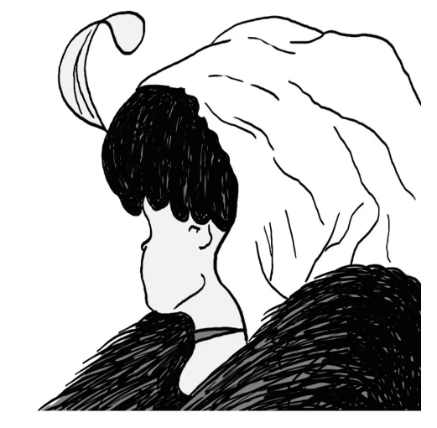

Convolutional Neural Networks
Notes:
Young lady looking away or old lady looking down?

Slide 2
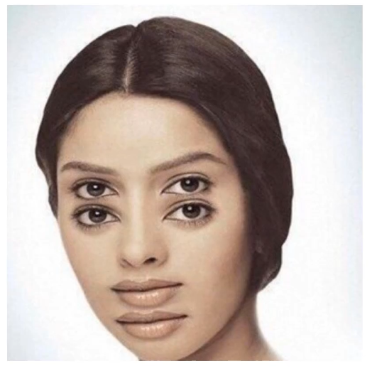

Slide 3
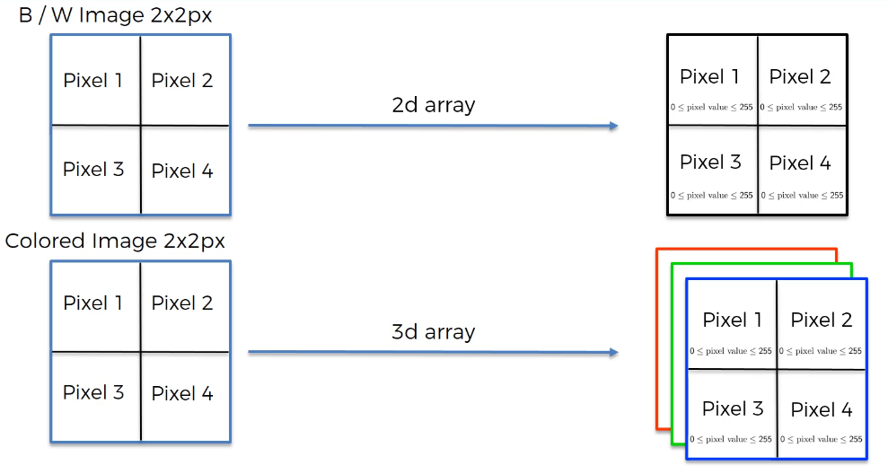

Slide 4
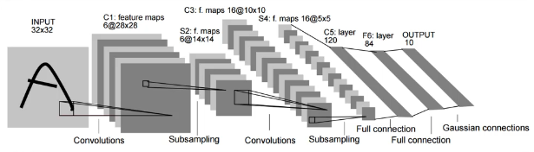
CNN Steps
Convolution (with ReLU)
Max Pooling
Flattening
Full Connection

Slide 5
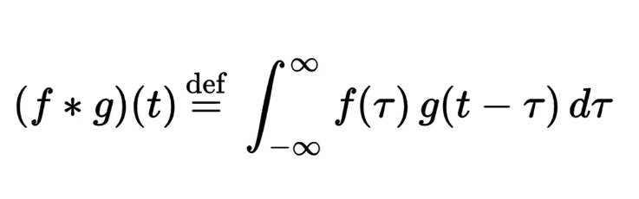
Step 1 - Convolution
This is the transformation in mathematical terms
The verb to use is “to convolve”
That translated from Math is ‘to combine’

Slide 6
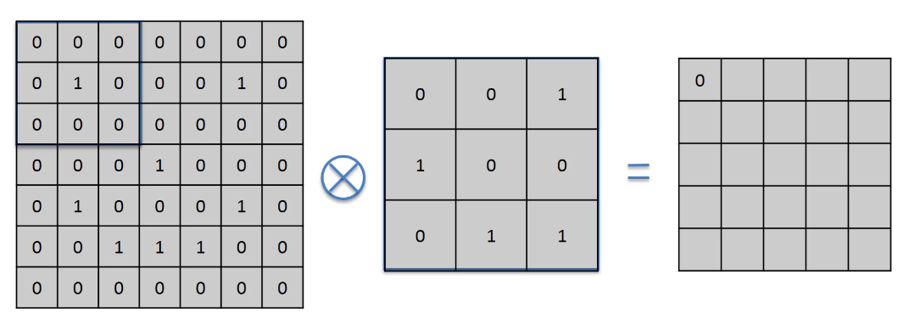
We multiply together the elements of these 3x3 matrices, position by position.
Then, we sum all the results together
All the multiplications are 0x1 or 1x0, so the sum is equal to 0
Input Image
Simplified as just 1s and 0s per pixel
Feature Detector
AKA Filter
Usually, 3x3 but it could be larger
It can contain negative values too
Feature Map
Simplified as just 1s and 0s per pixel
Notes:
The Feature Map can also be called Convolved map or Activation map

Slide 7
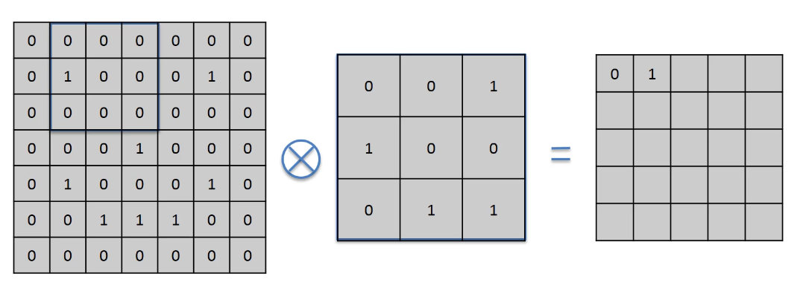
We multiply together the elements of these 3x3 matrices, position by position.
Then, we sum all the results together
Now, one multiplication is 1x1
Input Image
Simplified as just 1s and 0s per pixel
Feature Detector
AKA Filter
Usually, 3x3 but it could be larger
It can contain negative values too
Feature Map
Simplified as just 1s and 0s per pixel

Slide 8
The movement of this matrix is called stride
Here we have a stride of 1 pixel
Input Image
Simplified as just 1s and 0s per pixel
Feature Detector
AKA Filter
Usually, 3x3 but it could be larger
It can contain negative values too
Feature Map
Simplified as just 1s and 0s per pixel

Slide 9
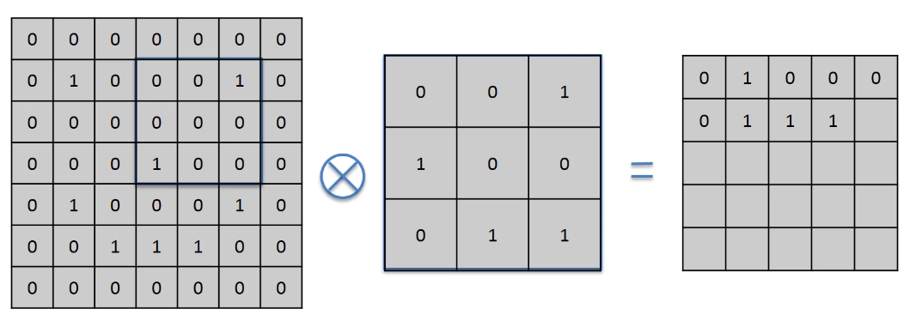
After 10 strides
Best values for the stride is by 1 or 2 pixels
Input Image
Simplified as just 1s and 0s per pixel
Feature Detector
AKA Filter
Usually, 3x3 but it could be larger
It can contain negative values too
Feature Map
Simplified as just 1s and 0s per pixel

Slide 10
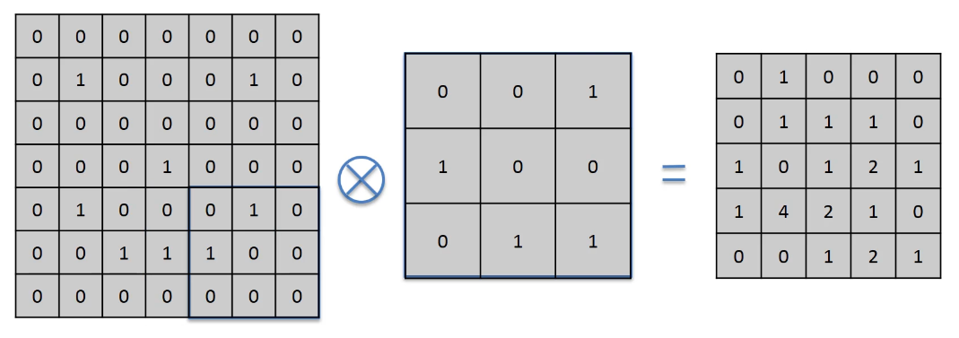
Input Image
Simplified as just 1s and 0s per pixel
Feature Detector
AKA Filter
Usually, 3x3 but it could be larger
It can contain negative values too
Feature Map
Simplified as just 1s and 0s per pixel

Slide 11
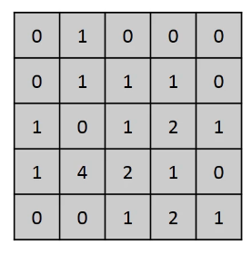
Step 1 - Convolution
What is the Feature Map? What did we obtain?
We reduced the size of the original matrix
The more, the larger is the stride
The higher are the numbers, the more precisely the detected feature appears in the original image
Note that it still preserves the spatial relationships between pixels
We don’t lose the pattern

Slide 12
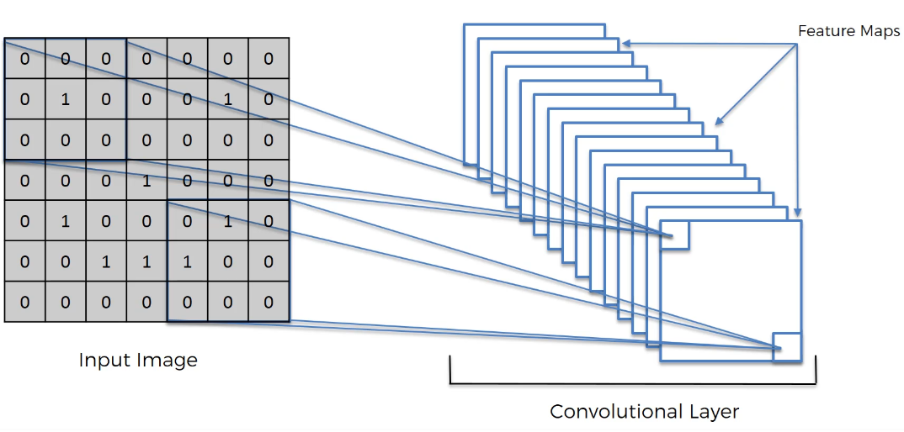
The network will be trained to recognize a series of Features that are then stored in a collection of Feature Maps
This is the Convolutional Layer

Slide 13

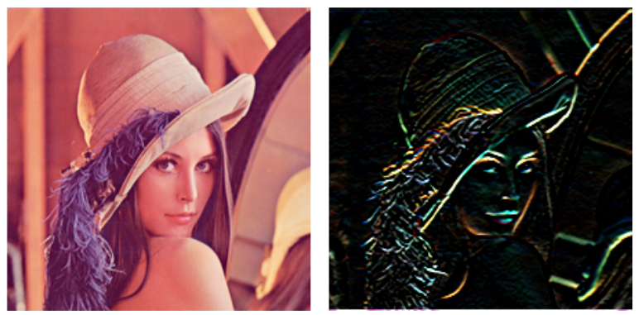
Step 1 - Convolution
Another example of Feature Detector (Horizontal edge)
Notes:
The lady in the picture is called Lenna
If you transpose the matrix, you get Vertical edge instead

Slide 14
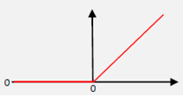
Step 1 - Convolution
After creating the set of Feature Maps, we need to add some non-linearity
We apply the Rectifier activation function (ReLU)
All the negative values become positive values
This helps reducing the graduality of the color palette.
Example: In a picture, colors go from bright to dark gradually.
If we remove the negatives, it will change more abruptly. Less linearly!

Slide 15
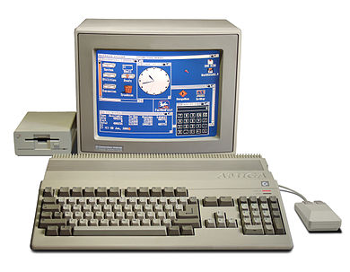
Step 2 - Pooling
We need to ensure that our neural network has a property called spatial invariance
Basically, that it doesn't care where the features are and doesn't care if the features are a bit tilted, different, relatively closer or farer apart, and so on.
Notes:
Commodore Amiga 500 <src=‘Wikipedia’>

Slide 16
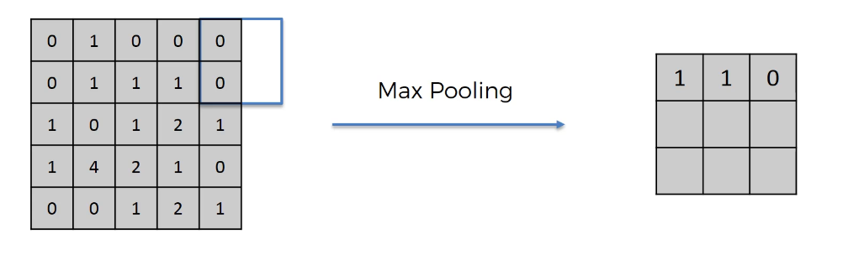
Step 2 - Pooling
Feature Map
We pick the maximum value in a 2x2 sub-square (the size can vary)
Stride is 2 here, but it can vary
If at the end of the row, we just continue
Pooled Feature Map
Each position contains the maximum value found in the sub-squares
Notes:
Note: there are also other types of pooling, like average and mean

Slide 17
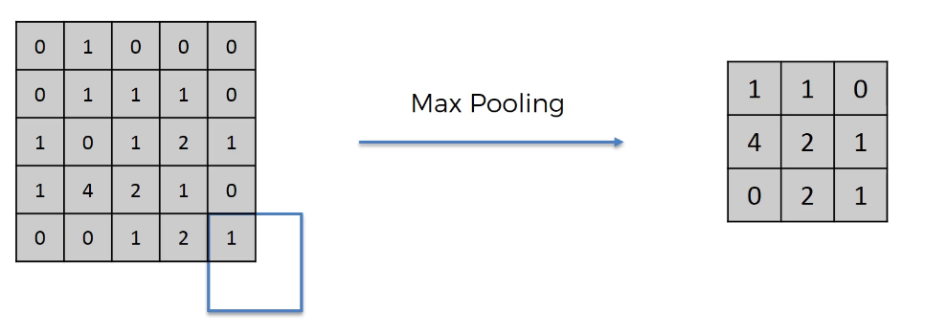
Step 2 - Pooling
Feature Map
We pick the maximum value in a 2x2 sub-square (the size can vary)
Stride is 2 here, but it can vary
If at the end of the row, we just continue
Pooled Feature Map
Each position contains the maximum value found in the sub-squares

Slide 18
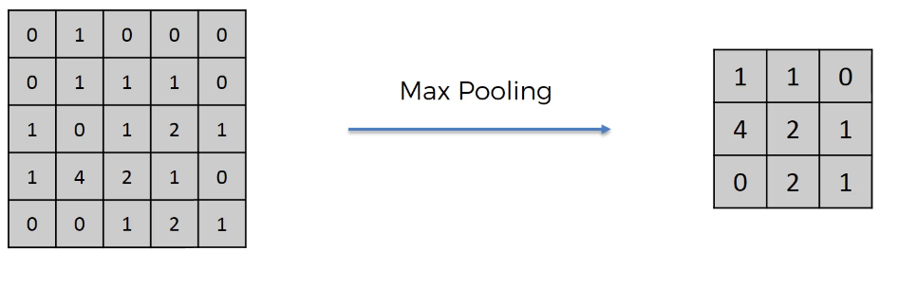
Step 2 - Pooling
Feature Map
Pooled Feature Map
In the Pooled Feature Map we pick the maximum value in a small area (the sub-square)
If in the Feature Map, the maximum value is moved in a different position, it will still be recognized and passed to the Pooled Feature Map
We are also reducing the size of the Map, helping the work of the final layer
Also, it reduces overfitting, because we are not training on the actual training data anymore

Slide 19
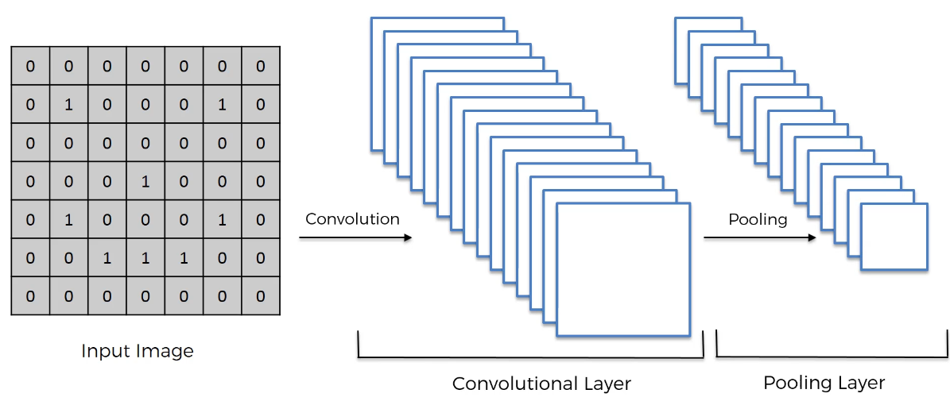
Convolution + Pooling
Notes:
Note: Pooling is applied to any Convolutional Layer

Slide 20
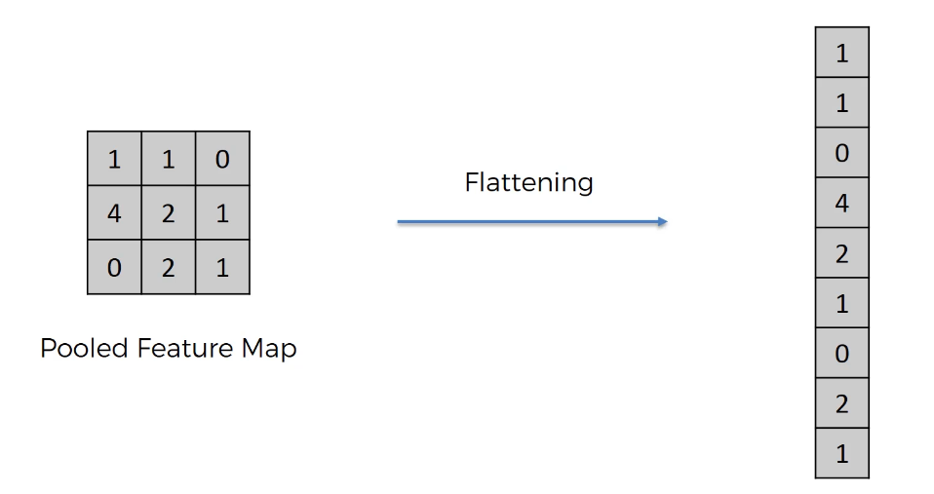
Step 3 - Flattening
Simply, we convert the matrices in a vector (by rows)

Slide 21
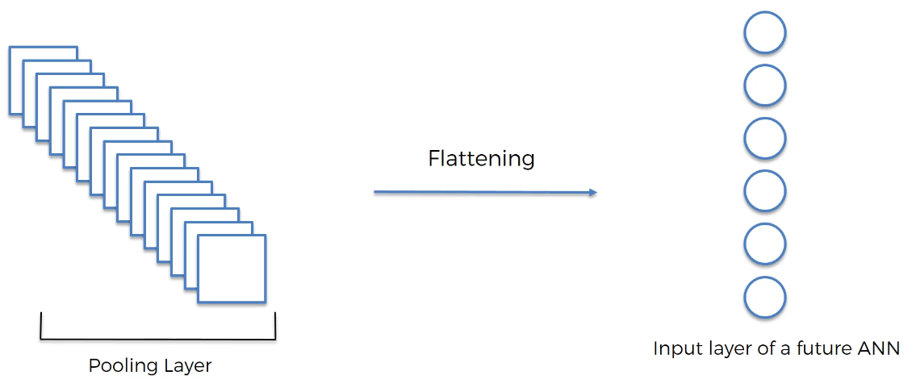
Step 3 - Flattening
Simply, we convert the matrices in a vector (by rows)

Slide 22
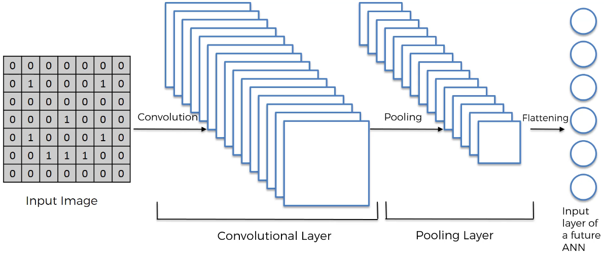
Convolution + Pooling + Flattening

Slide 23
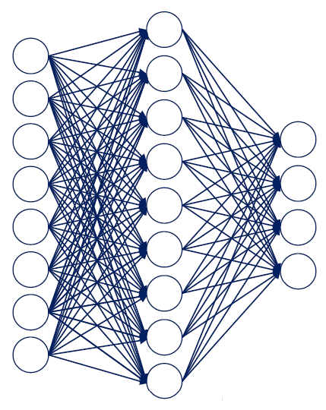
Step 4 – Full Connection
We finally attach the ANN
Input Layer
Output Layer
Note that in CNNs, the hidden layers are called “Fully Connected Layers”
Fully Connected Layer/s
Notes:
We could have more Hidden Layers, of course
Note: the Flattening output should have the same number of “nodes” as the Input Layer (the image lacks a couple).

Slide 24
Step 4 – Full Connection
Input Layer
Output Layer
In this network, though, the backpropagation will not simply identify the weights to update, but also the “features”
In fact, the Feature Detectors are also modified based on the error (via gradient descent)
Fully Connected Layer/s
Notes:
We could have more Hidden Layers, of course
Note: the Flattening output should have the same number of “nodes” as the Input Layer (the image lacks a couple).

Slide 25
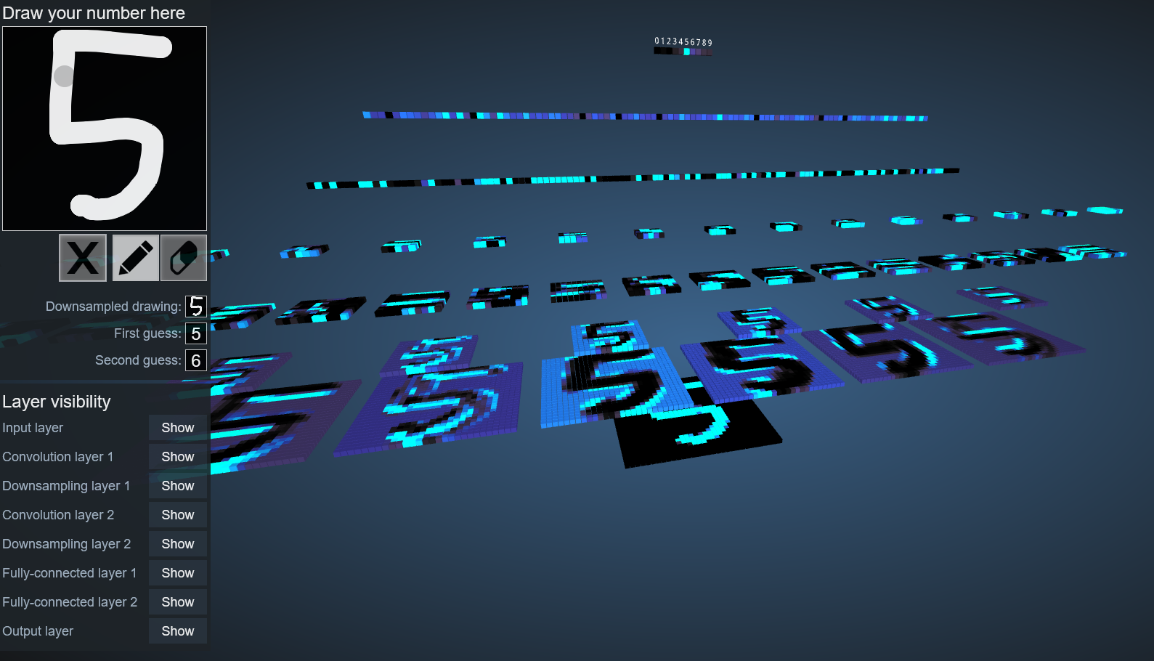
Check this out:
https://www.cs.ryerson.ca/~aharley/vis/conv/
Notes:
There is also a “flat” version: https://www.cs.ryerson.ca/~aharley/vis/conv/flat

Slide 26
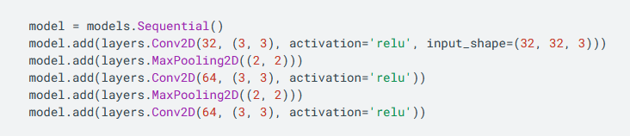
CNNs in TensorFlow
https://www.tensorflow.org/tutorials/images/cnn

Slide 27

Dropout
To reduce overfitting, we can apply Dropout to the network
Basically, a form of regularization
The idea is that we let a layer to randomly drop out a few output units from the layer itself during the training process
By setting the activation to zero
We can pick the percentage of the output units that are dropped out randomly from the applied layer. Example:

